Slide 1
OOP C++
Person1 attacks person2
person1.attack(person2);
attack(person1, person2);

Slide 2
Terms
Object: data + functionality
Class: blueprint for object
Abstraction: hiding inner workings
Encapsulation: combining related things in one common object
Polymorphism: ability to use operator/function in more than one way
Overloading: redefining a function/operator to work on a new data type

Slide 3
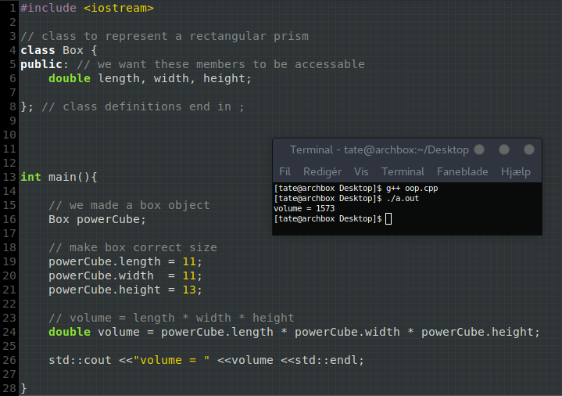
OOP example 1
we created a new type Box which has properties/members length, width, and height
we made an instance of our Box class named powerCube
Note: class definitions must end in ;
we can access public object members using the dot operator
we set our new box object to the dimensions of the powercube using dot operator
we calculate the volume of the box using l*w*h
All of this could be accomplished without using objects, but having objects in libraries makes code easier to understand.

Slide 4
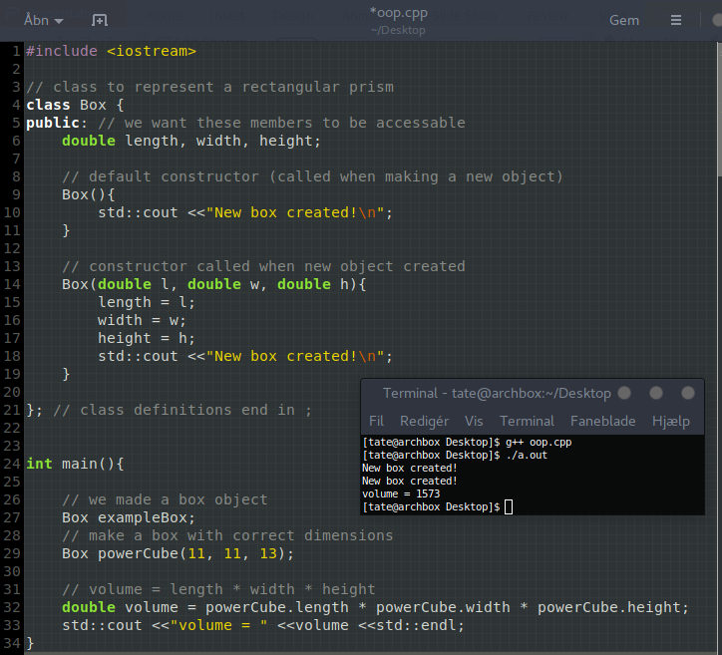
Constructors
here we have 2 constructors
The first one is used to create exampleBox
The second one is used to create powerCube

Slide 5
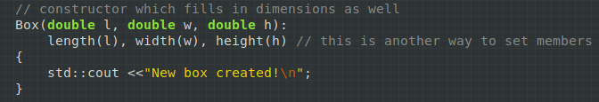
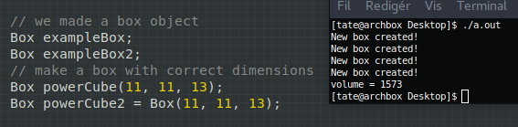
More on constructors and making objects
Alternatively we could have used this constructor and saved some lines. You are more likely to see this method of initializing members.
There are several ways to "instantiate" objects from classes.

Slide 6
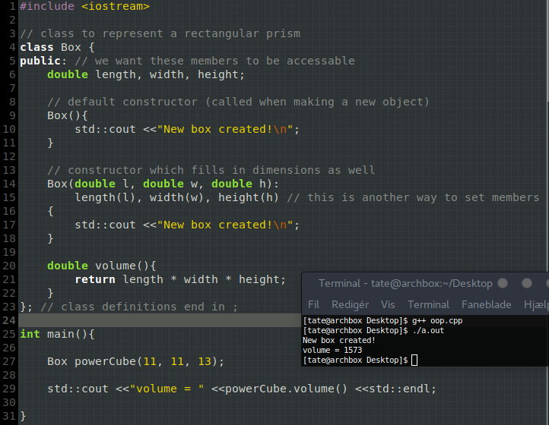
Member functions
Member functions are used just like other members, defined in the class body and accessed via the dot operator.
Member functions are also known as "methods," but this term is less commonly used for C++.

Slide 7
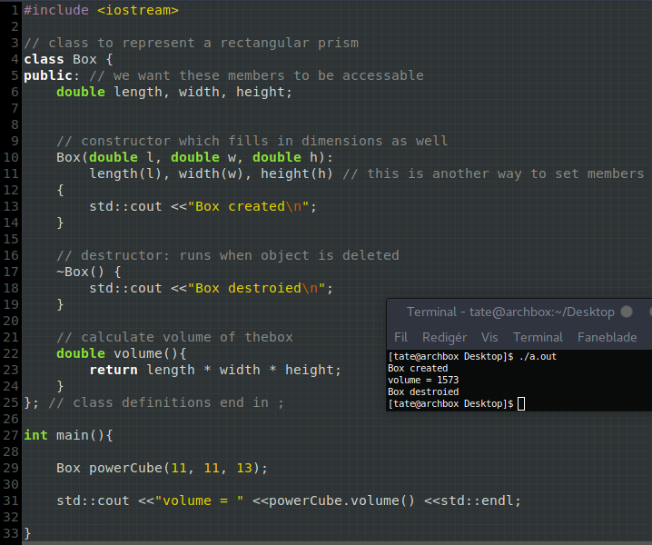
Destructors
Destructors are special functions called when the object is deleted.
They are similar to constructors except they are preceded by a `~` (tilde) and cannot take arguments

Slide 8
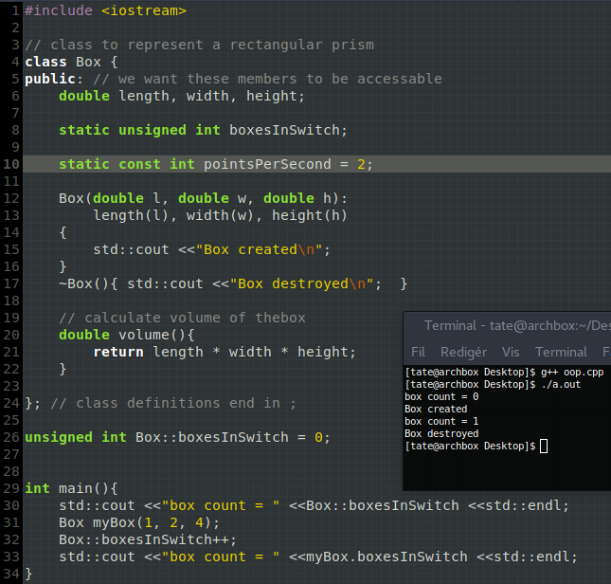
Static members
Static members are shared across all objects of the same type.
Static members are accessed using the scope operator (::) and the class name, or they can be accessed using the dot operator and an object.
For some reason non-const static members have to be initialized outside the class body (I didn't know this until now, although explanation seems reasonable).
Note: we can also have static member functions

Slide 9
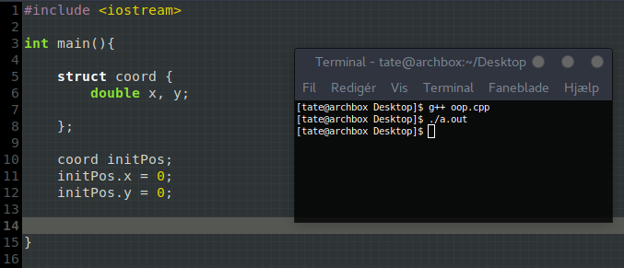
Structs - basically objects
struct = data-structure
in C structs can only have data members, however in C++ the main difference between structs and classes is that struct member are public by default.
We generally use structs for less complicated types

